Slide 1
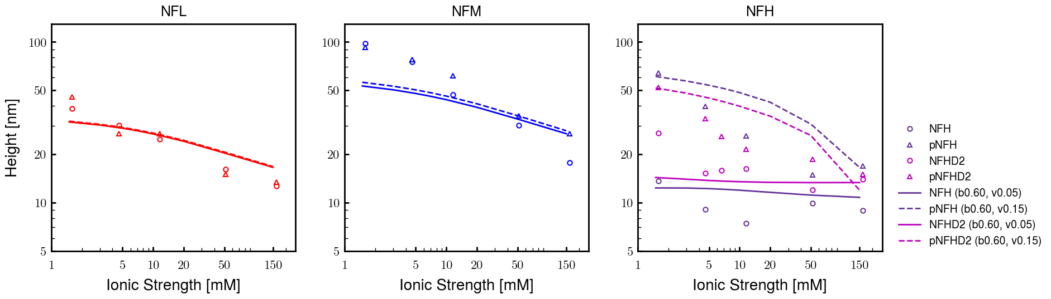
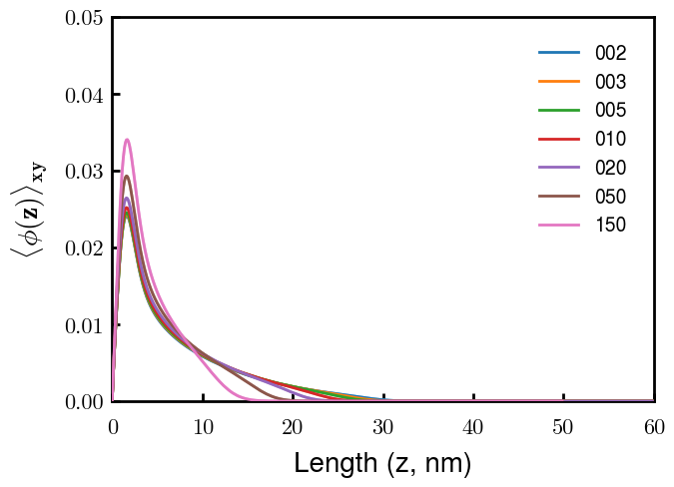
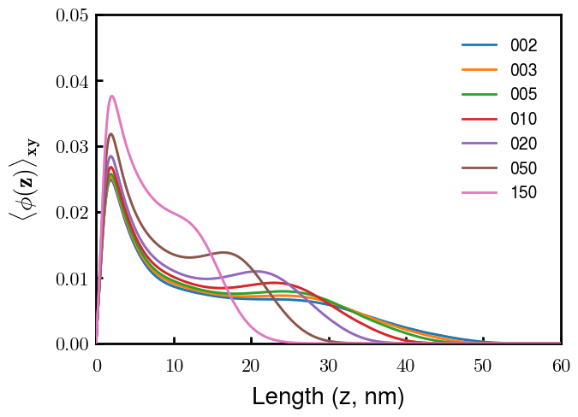
NFL
NFM
Next slide
Notes
pNFM running now; NFHb60v05c150 (cm225) running now
All non-phos same b,v
Phos L, M same as non-phos (few KsP)
Phos H 0.05 → 0.15 nm3
Potential improvements
Recheck pNFH(D2); no better option?
Recheck NFM; no better reasoning than b(s)?

Slide 2
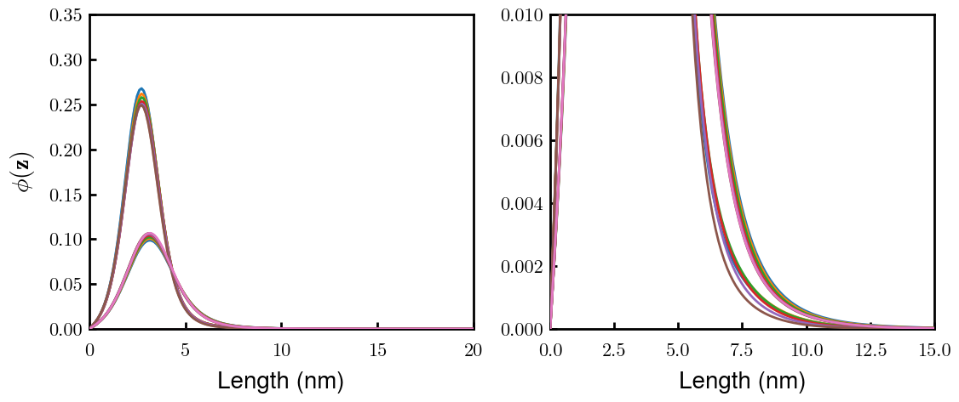
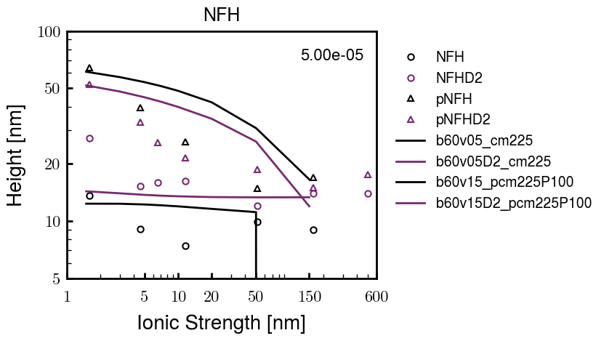
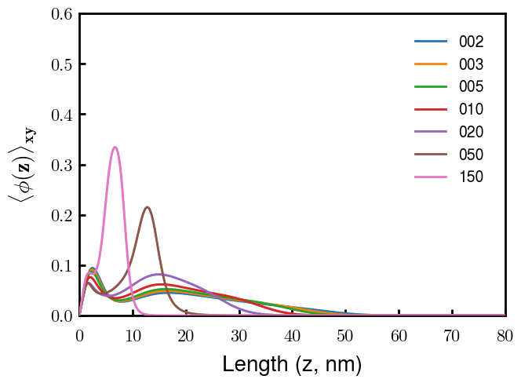
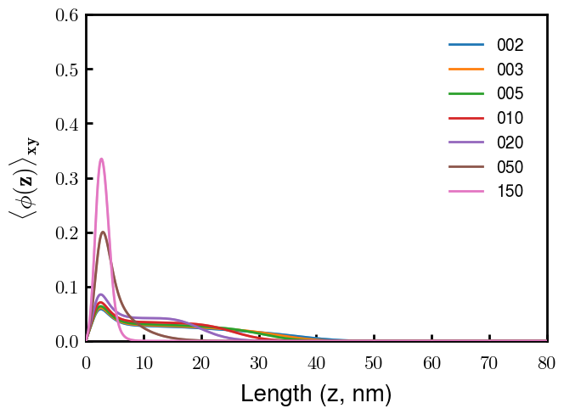
(p)NFH(D2)
NFH
NFHD2
pNFH
pNFHD2
(v = -1)
Points
v05 → v15 after phosphorylation
No condensed multilayer but worse fit

Slide 3
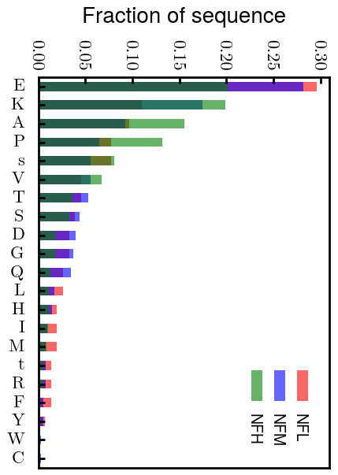
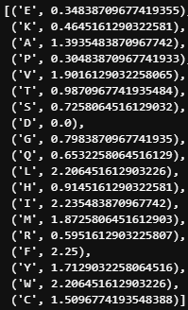
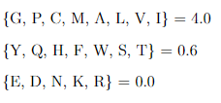
Chi (scaled)
Chi (BM 2023)
D: 3.65 (-1.00e);
E: 4.25 (-1.00e);
K: 10.53 (1.00e);
R: 12.48 (1.00e);
H: 6.00 (0.035e)
Note: N should be in bin 2 (not in NFH anyways)

Slide 4
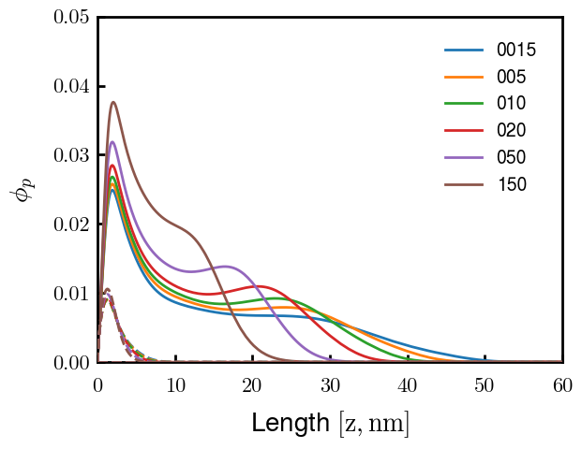
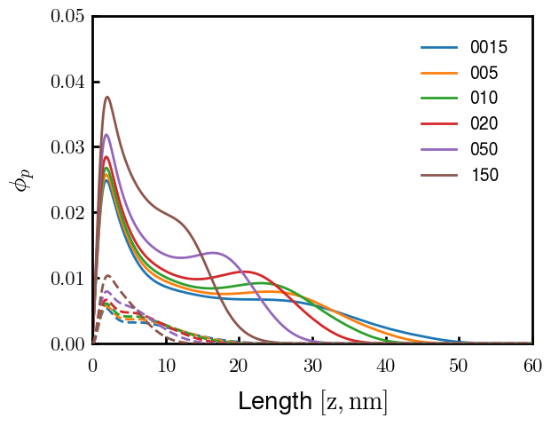
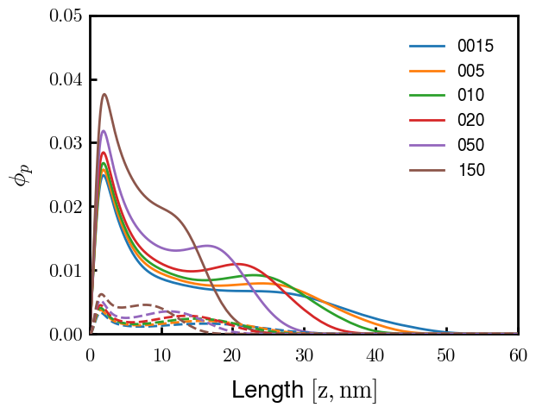
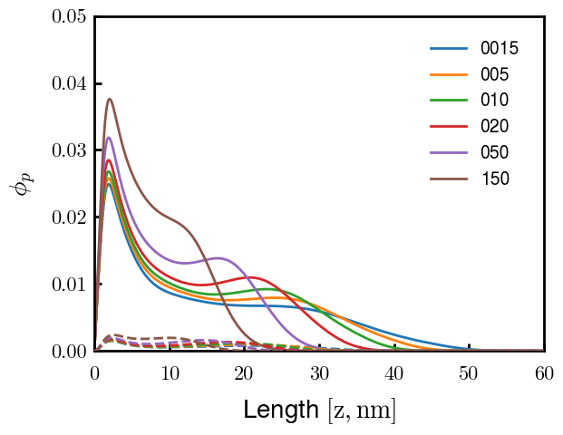
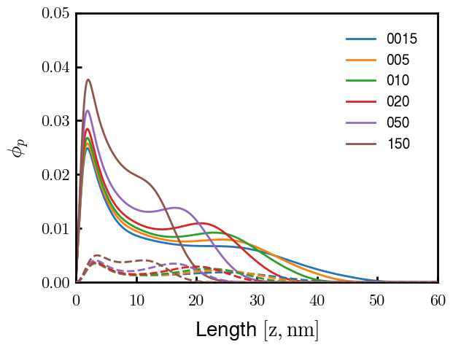

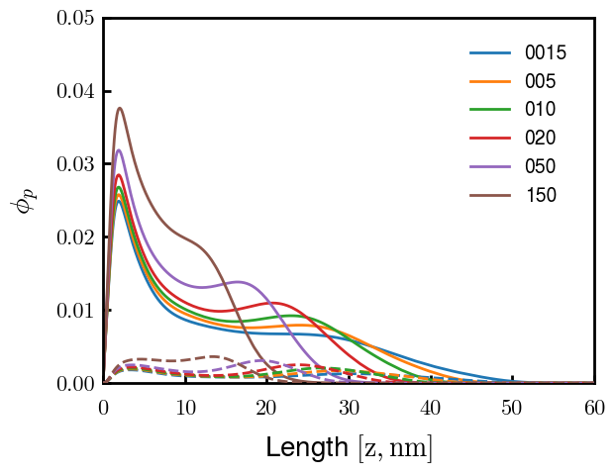
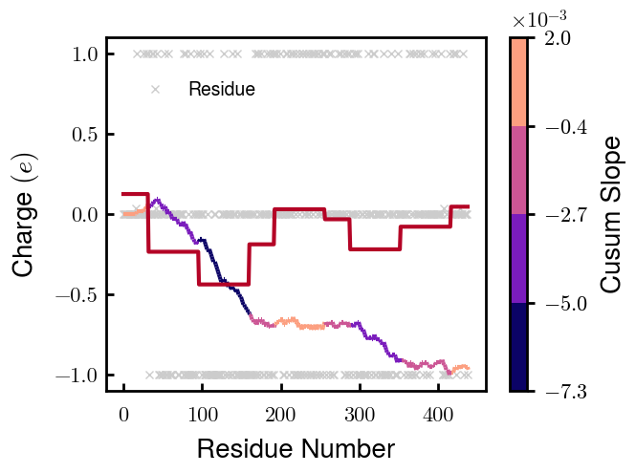

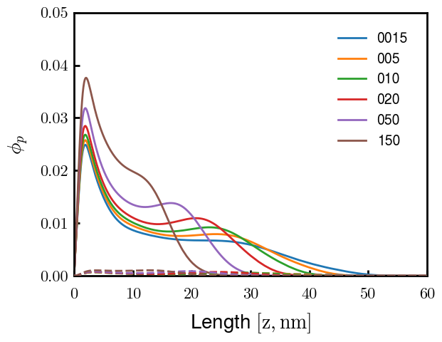
3
4
1
2
6
7
5
8
9

Slide 5
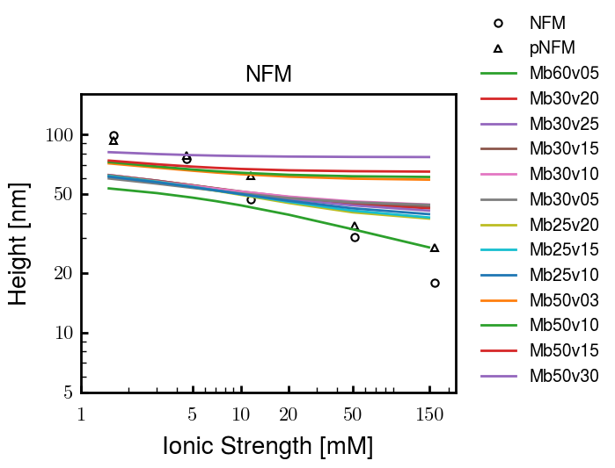
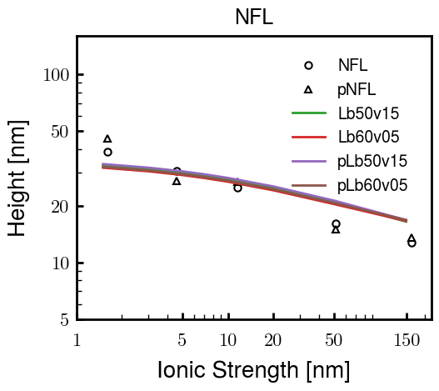
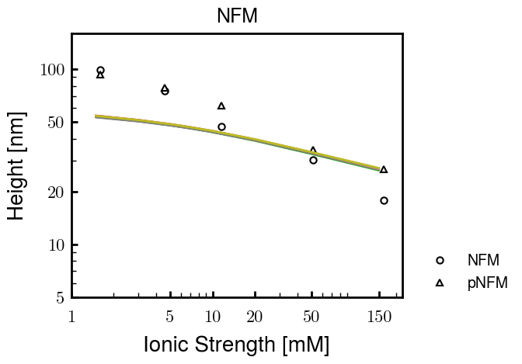
Other fits
Note: disc N = 5, 6, 8 , 9, 11, 13, 15 same for Mb60v05_NX and Mb30v25_NX

Slide 6





Slide 7
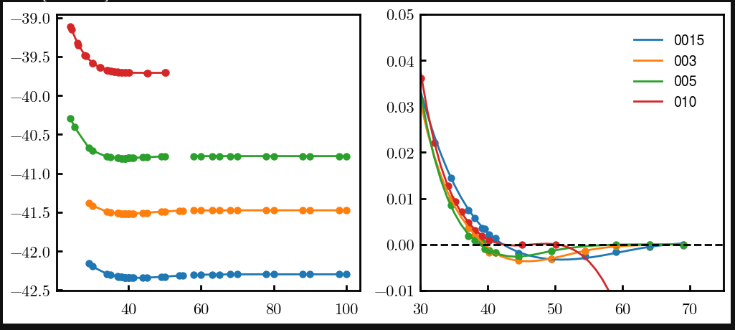
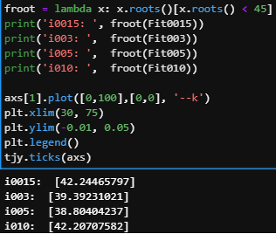
Try approaching surface

Slide 8




NFH (original); 31, 4
NFHD2; 40, 4
D2: delete 36-72
Rerun alg on D2
NFH (phos); 36, 4
NFHD2 (phos); 33, 4
Note: not currently doing this

Slide 9
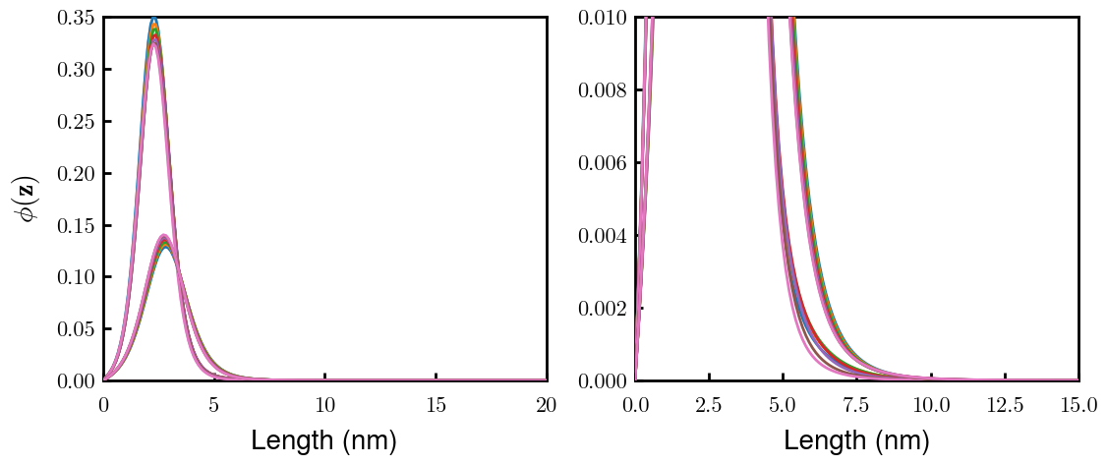
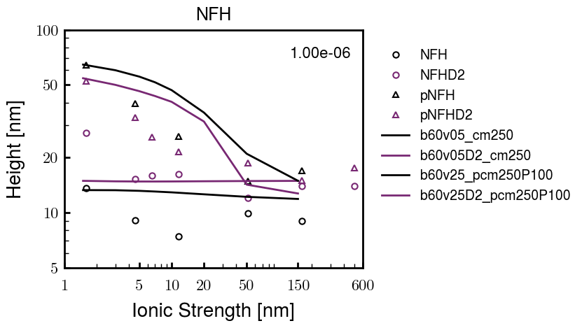
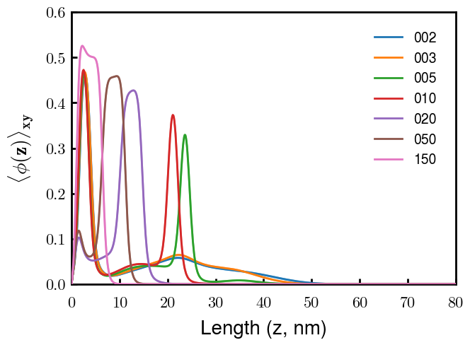
Best fit w/ consistent chi_max
NFH
NFHD2
pNFH
(v = -1)
Points
v05 → v25 after phosphorylation
Bilayer (trilayer for 5?) pNFH morphology

Slide 10
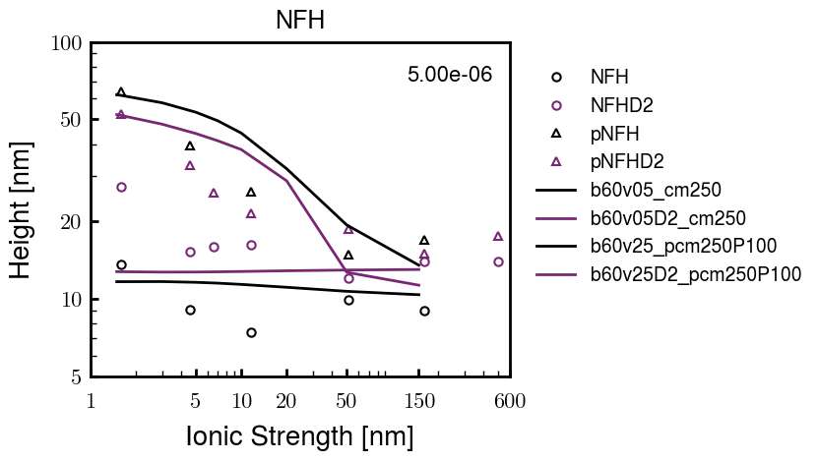
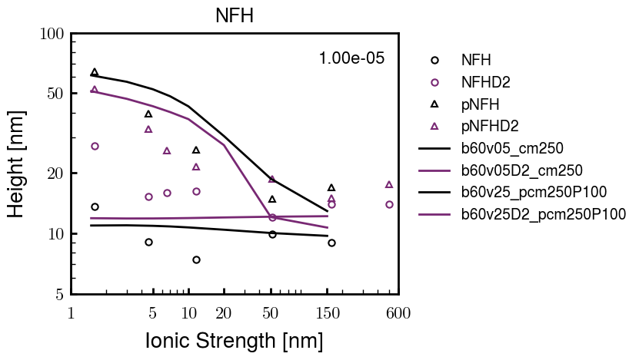
Same params as prev. w/ diff thresh

Slide 11
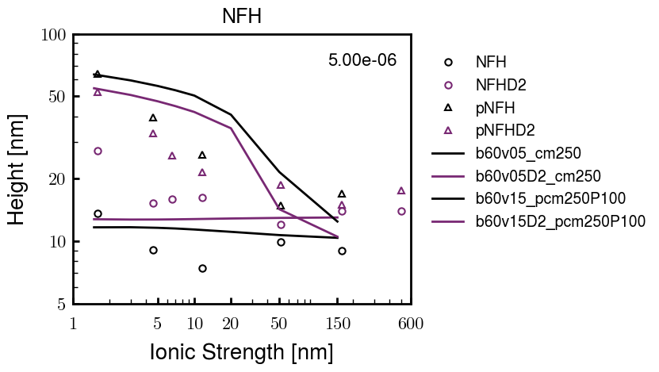
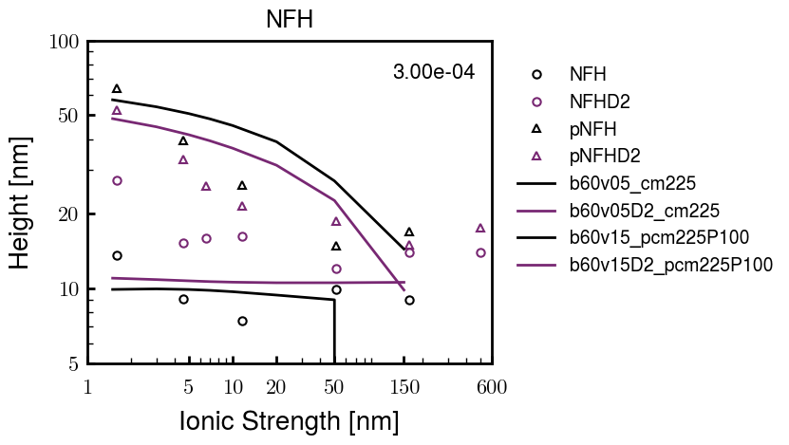
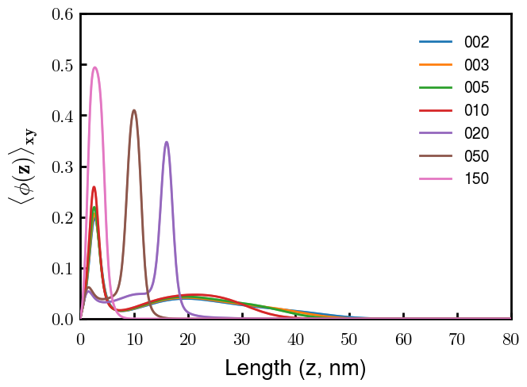
Find best without multilayer
pNFH
pNFH
(v = -1)
(v = -1)
Multilayer at 20

Slide 12
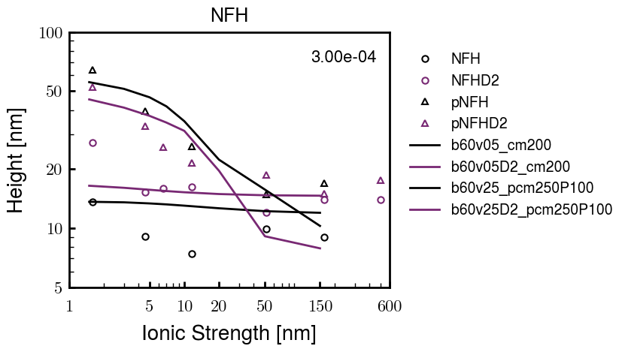
Best pNFH scaling fit (no regard to realistic)
pNFH
(v = -1)
Points
v05 → v25 after phosphorylation
cm200 → cm250 after phospho
Multilayer
Phospho < native

Slide 13






Native NFH

Slide 14







NFHD2

Slide 15




pNFH(D2)
4e-03

Slide 16





1e-06
4e-03
norm
4e-03
Try to bring pNFH down → {cmXX + PXX} only choice
norm
4e-03

Slide 17

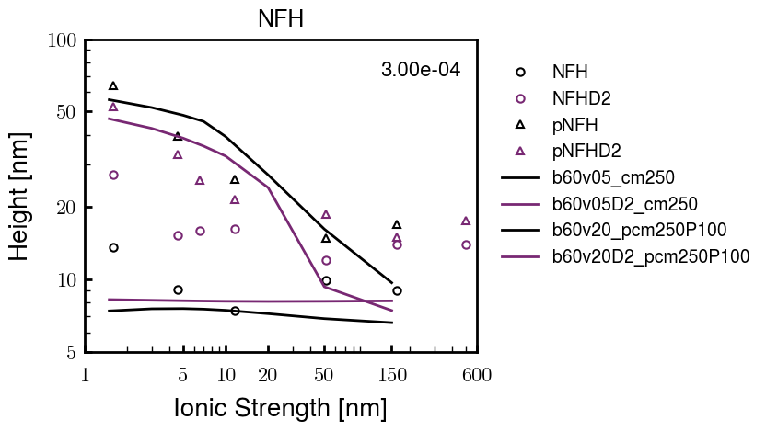


3e-04
3e-04
3e-04

Slide 18





Heights.params : b60v05 cm200
norm
1e-06
1e-05
1e-04
4e-03

Slide 19






Heights.params : b60v05 cm250
norm
ylog
norm
ylin
1e-06
1e-05
1e-04
5e-03

Slide 20




Heights.params: b60v10 cm{200, 225}
norm
1e-06
1e-05
1e-04
5e-03

Slide 21



Slide 22

 | Slope Bins 4 | Smear Count 25
Block number | Alpha w/ Henderson Hasselbalch | Chi Chi_max = 2.2
[0 50] | 0.040012 | 1.160000
[50 75] | -0.278451 | 0.720000
[75 125] | -0.519707 | 0.608000
[125 156] | -0.154453 | 0.529032

Slide 23

 | Slope Bins 4 | Smear Count 31
Block number | Alpha w/ Henderson Hasselbalch | Chi Chi_max = 2.2
[0 31] | 0.001103 | 0.922581
[31 62] | -0.386873 | 0.703226
[62 93] | -0.290146 | 0.967742
[93 496] | 0.037164 | 1.098759
[496 527] | -0.064533 | 0.819355
[527 620] | 0.010682 | 0.756989
[620 647] | -0.103326 | 0.696296

Slide 24






Previous
New

Slide 25





Slide 26


Response to stimuli given composition
Same data
Effect of composition given environment

Slide 27


NFL, pH 7.44, phos 1.5e (locs from LCMS)
Non-phos NFL
Block number | Alpha w/ Henderson Hasselbalch | Chi Chi_max = 3.2
[0 50] | 0.040012 | 1.540000
[50 75] | -0.278451 | 0.960000
[75 125] | -0.519707 | 0.868000
[125 156] | -0.154453 | 0.690323
 | Slope Bins 4 | Smear Count 25
Block number | Alpha w/ Henderson Hasselbalch | Chi Chi_max = 3.2
[0 50] | -0.019988 | 1.540000
[50 75] | -0.278451 | 0.960000
[75 125] | -0.519707 | 0.868000
[125 156] | -0.154453 | 0.690323

Slide 28

NFM, pH 7.44, phos 1.5e (locs from LCMS)
 | Slope Bins 4 | Smear Count 32
Block number | Alpha w/ Henderson Hasselbalch | Chi Chi_max = 3.0
[0 32] | 0.079143 | 1.275000
[32 64] | -0.186340 | 1.125000
[64 96] | -0.327964 | 1.181250
[96 160] | -0.460694 | 0.787500
[160 224] | -0.124999 | 1.115625
[224 288] | -0.023510 | 0.956250
[288 352] | -0.242085 | 1.003125
[352 384] | -0.031302 | 1.125000
[384 416] | -0.123860 | 1.050000
[416 438] | 0.046945 | 1.281818

Slide 29





Bin 3 NFM, pH 7.44, phos 1.5e (locs from LCMS)

Slide 30




Bin 5 NFM, pH 7.44, phos 1.5e (locs from LCMS)

Slide 31



Phos 2 NFM, pH 7.44, phos 2.0e (locs from LCMS)

Slide 32



Chi 2.5 NFM, pH 7.44, phos 2.0e (locs from LCMS)

Slide 33



NFM, pH 7.44, non-phos

Slide 34


NFH, pH 7.44, phos 1.5e (locs from LCMS)
 | Slope Bins 4 | Smear Count 36
Block number | Alpha w/ Henderson Hasselbalch | Chi Chi_max = 3.2 | Chi Chi_max = 3.0
[0 36] | 0.000945 | 1.266667 | 1.20000
[36 72] | -0.527455 | 0.900000 | 0.85000
[72 324] | -0.208376 | 1.729365 | 1.628571
[324 396] | -0.111195 | 1.416667 | 1.333333
[396 432] | -0.152824 | 1.344444 | 1.266667
[432 647] | -0.033955 | 1.077209 | 1.015814

Slide 35




Phos block dashed
Phos block dashed

Slide 36



Best are b3.0 v2.0 and b3.0 v3.0, but max H not high enough
Possible solutions:
Lower chi_max
Change aa_disc to have more charge
Force spectra?
Better for low salt, but high salt will melt brushes together

Slide 37



M1
pMx5

Slide 38



b3.00; v1, 2
b4.00; v2, 2.5, 3, 5, 10
b5.00; v3, 10, 15, 40
53 Nk
39 Nk
32 Nk

Slide 39
Binary results

Slide 40



Matrix Approach
Updated 04/04/2023

Slide 41














H Vol decrease (by v)
H Vol decrease (by b)
Desired “linearity” by tuning /thresh/ based on polymer density of expelled NFL
L Vol decrease (by b)
Comes at severe cost of overall height. Have to minimize outer concentration to approach pure thresh of 1e-06

Slide 42














H Vol decrease (by v)
H Vol decrease (by b)
Chimax 3.5
Desired “linearity” by tuning /thresh/ based on polymer density of expelled NFL
L Vol decrease (by b)
Comes at severe cost of overall height. Have to minimize outer concentration to approach pure thresh of 1e-06

Slide 43








F (3.5)
Chimax 3.5
Chimax 3.0
Scaled by 1.5
Scaled by 1.6
Scaled by 1.6
Scaled by 1.5
Scaled by 1.5
Scaled by 1.5
Scaled by 1.8
Scaled by 1.8

Slide 44
















Last test: same stiffness factor (b^3/v0) but with varying total volume

Slide 45












H Vol decrease (by v)
H Vol decrease (by b)
a2C_30
a2D_30
a2E_30
Rerun for Cs
b1C_30
b1D_30
b1E_30
L Vol decrease (by b)
a1C_30
a1D_30
a1E_30
g1C_30
g1D_30
g1E_30
Rerun for Cs

Slide 46












H Vol decrease (by v)
H Vol decrease (by b)
a2C
a2D
a2E
b1C
b1D
b1E
Block 4 (NFL end)
L Vol decrease (by b)
a1C
a1D
a1E
g1C
g1D
g1E

Slide 47









H Vol decrease (by v)
Chimax 3.5
H Vol decrease (by b)
a2C_30
a2D_30
a2E_30
b1C_30
b1D_30
b1E_30
L Vol decrease (by b)
a1C_30
a1D_30
a1E_30
g1C_30
g1D_30
g1E_30

Slide 48







For i as L and H:
Pure height profiles
Mixed height profiles
Current L library
Current H library
Skip; marginal increase in vol prob not enough
Move onto chi3.0; larger NFL vol library

Slide 49





NFL
All plotting wrong L pure; look only at purp
NFH
H volume too low to neutralize L (v = 31 nm3/c)

Slide 50







H volume v = 60 nm3/c

Slide 51







H volume too low to neutralize L

Slide 52










NFH, V = 70
L30

Slide 53





NFH & NFL v = 0.15
a2D
b1D
g1D

Slide 54





Based on NFH b5v15c3, apply VL = VH
NFL and NFH are from same amino acids but diff chain lengths. Should VL = VH?
L30 / H70
L80 / H20
L30 / H70
L80 / H20

Slide 55






L30 / H70
L80 / H20
L30 / H70
L80 / H20

Slide 56
L Fitting

Slide 57


VL = VH

Slide 58







Try b change, v same as H (0.15)
Phi unrealistic (?)
Phi unrealistic
Phi very unrealistic
Phi very unrealistic

Slide 59






Try similar params to H
5.6
11.2
16.8
28
56
7.5
11.25
18.75

Slide 60







Try similar params to H, b0.36
7.8
15.6
23.4
31.2
Unrealistic vol
Not very sensitive to v; not high enough to intersect neighboring chains (function of b and sigma)

Slide 61


Continuation from prev params

Slide 62







v2.7 and some fine
b1.50 v2.7 c3.2
b1.75 v2.7 c3.2
b1.75 v2.5 c3.2
b1.75 v2.5 c3.0
b2.0 v2.7 c3.2
b2.25 v2.7 c3.2
b2.50 v2.7 c3.2
Phi too small to decrease v0

Slide 63










b2.0 v10.0 c3.0
b2.0 v8.0 c3.0
b2.0 v6.0 c3.0
b2.0 v4.0 c3.0
b2.0 v2.0 c3.0
Phi limit
b1.8 v10.0 c3.0
b1.8 v8.0 c3.0
b1.8 v6.0 c3.0
b1.8 v3.0 c3.0
b1.8 v2.0 c3.0
Phi limit

Slide 64





b1.6 v10.0 c3.0
b1.6 v8.0 c3.0
b1.6 v6.0 c3.0
b1.6 v2.0 c3.0
b1.6 v1.5 c3.0
Phi limit

Slide 65









b2.0 v2.7 c3.2
b3.0 v3.5 c3.5
b3.0 v7.0 c3.5
b3.0 v7.0 c3.0
Phi too small
Phi too small to decrease v0
b4.0 v12.0 c3.0
b5.0 v20.0 c3.0
b5.0 v20.0 c4.0
b5.0 v5.0 c3.0
b5.0 v10.0 c3.0
Phi too small to decrease v0

Slide 66





v20
b5.0 v20.0 c3.0
b4.5 v20.0 c3.0
b4.0 v20.0 c3.0
b3.5 v20.0 c3.0
v10
b5.0 v10.0 c3.0
b4.0 v10.0 c3.0
b3.0 v10.0 c3.0
b2.0 v10.0 c3.0

Slide 67




b2.00 v2.70 c3.20
b2.00 v2.75 c3.20

Slide 68
NFH fitting (from NFL best fit)

Slide 69








b1.00, v0.50, c3.2
b2.00, v4.00, c3.2, th2.5e-02
b1.00, v2.00, c3.2
b1.00, v1.00, c3.2

Slide 70
Mixture

Slide 71



Slide 72


b = 0.75

Slide 73





Slide 74
b = 1.0

Slide 75





Slide 76
b = 1.25

Slide 77




Chi 2.6
Bad vol frac

Slide 78








b25v0
b25v1
b25v2
b25v3

Slide 79




Chi 2.8
Bad vol frac

Slide 80





Slide 81
b = 1.50

Slide 82






Chi 2.8
Bad vol frac

Slide 83





Slide 84

b = 2.00
v4 = 0.25*b^3

Slide 85


Bad vol frac

Slide 86



Slide 87
Fine tune

Slide 88



b1.25, v1.95, c3.0
b1.50, v3.38, c3.0
b2.00, v4.00, c3.0
Norm seems to capture kinked behavior

Slide 89




Slide 90



b1.25, v1.95, c3.2
b1.50, v3.38, c3.2
b2.00, v4.00, c3.2

Slide 91




Slide 92


b1.25
b1.50
b2.00
c2.8
c3.0
c3.2

